Slide 1

REGIONAL STRATEGY AND ACTION PLAN FOR THE CONTROL OF African Swine Fever (ASF) IN AFRICA
Joint Strategy of AU-IBAR, FAO AND ILRI
Dr. Hiver Boussini (AU), Dr. Daniel Beltran-Alcrudo (FAO) Dr. Edwards Okot (ILRI)
2nd GARA Scientific Workshop, 10-14 November 2014
Pretoria, South Africa

Slide 2
Outline
ASF Control Strategy IN AFRICA
Action Plan
Next Steps

Slide 3
REGIONAL STRATEGY FOR THE CONTROL OF AFRICAN SWINE FEVER IN AFRICA

Slide 4


ASF Control Strategy ….
Vision and Overall Goal
An African continent where ASF no longer constrains sustainable pig production and rural development or threatens livelihoods
Reduce the impact of ASF on the pig sector in Africa thereby i) promoting viable pig production and ii) improving the livelihoods of all pig/pork value chain actors, especially the poor

Slide 5
ASF Control Strategy…
Objectives
To control ASF in infected countries and
To prevent the introduction of ASF into non-infected countries
Objectives

Slide 6
ASF Control Strategy…
Expected Outputs
Knowledge Creation
Epidemiology and socio-economic drivers for ASF status, spread, prevention and control are better understood
Knowledge Transfer
Awareness of farmers, traders, butchers and other pig sector stakeholders is raised
Capacity Building
Capacities of veterinary services in disease detection, diagnosis, surveillance, management, contingency planning and emergency response as well as risk analysis are strengthened

Slide 7
ASF Control Strategy…
Expected Outputs
Application of Measures
Prevalence and incidence of ASF are reduced
Impact Reduction
Performance of pig and pork value chains are improved

Slide 8
ASF Control Strategy…
Components
Surveillance
Diagnosis
Coordination, Partnership & Resource Mobilization
Awareness & Communication
Disease Management
Biosecurity
Legislation & Policy
Research
ASF Strategy Elements

Slide 9
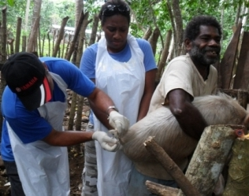
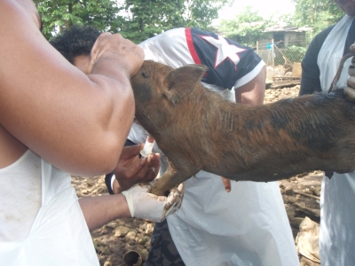
ASF Strategy Components…
Surveillance
Strengthen epidemio-surveillance systems
Disease reporting and prompt notification
Surveillance network
Awareness creation of surveillance stakeholders
Capacity building i.e. training, infrastructure, logistics etc..

Slide 10
ASF Strategy Components…
Surveillance Components
Disease Reporting
Components of SURVEILLANCE
Data & Sample Collection
Epidemiological Investigation
Information Communication
Data Analysis
ACTION

Slide 11
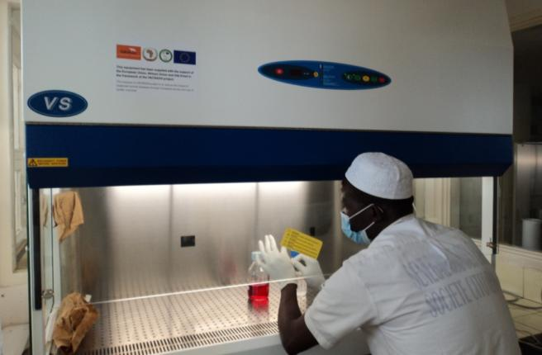
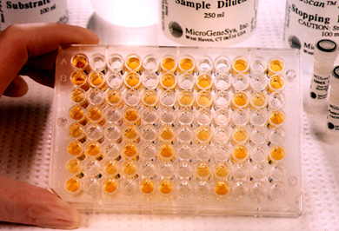
ASF Strategy Components…
Lab Diagnosis
Capacity to undertake basic and advanced diagnostic tests
Capacity to collect and transport samples to regional labs
Capacity building i.e. training, infrastructure, logistics etc…
Twining
Lab networking

Slide 12
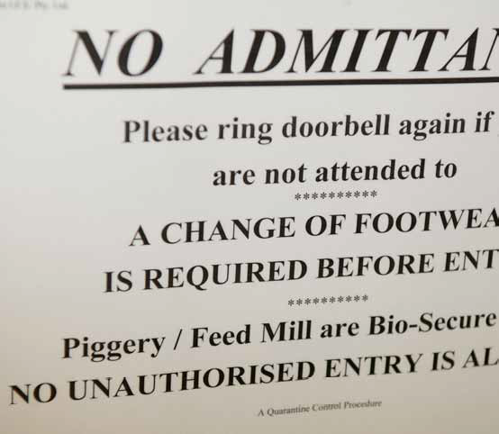
ASF Strategy Components…
Biosecurity
Raise awareness of actors
Continuous dialogue with stakeholders
Technical capacity
Improve husbandry and bio-security practices
Gradual transformation of production system – scavenging into semi-intensive system
Improve HACCP and waste management procedures

Slide 13
ASF Strategy Components…
Disease Management
Early notification and rapid response
Movement control and quarantine
Stamping out with compensation
Cleaning and disinfection

Slide 14
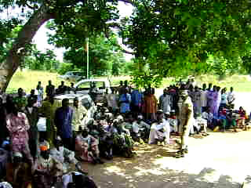
ASF Strategy Components…
Awareness & Communication
Development of communication & awareness raising strategy involving actors along value-chain,
Advocacy
Education
Extension and
Social mobilization interventions through strategic alliances with civil society in disease management, control and surveillance.

Slide 15
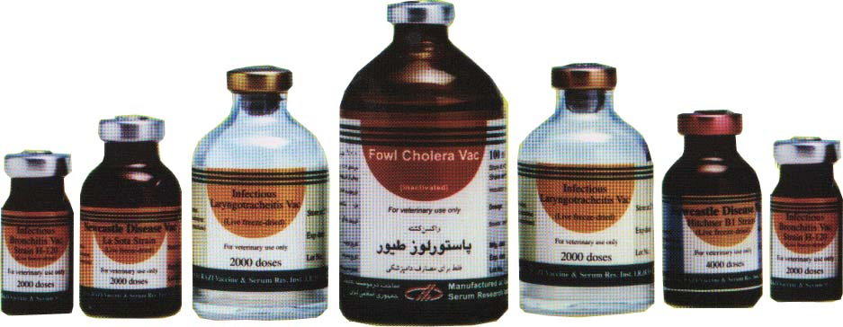
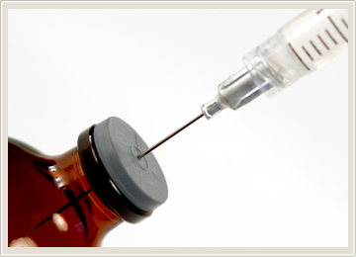
ASF Strategy Components…
Research
Vaccine development,
Risk factors understanding,
Virus strains and characteristics,
Role of ticks
Role of wildlife, etc…

Slide 16


ASF Strategy Components…
Legislation and Policy
Compensation schemes
Enforcement of veterinary legislation , movement control & other existing policies
Harmonization of policies and legislation
Commitment by governments

Slide 17

ASF Strategy Components…
Coordination & Partnership
Coordinated and collective efforts for complementarity, synergy and reduction of duplication Maximum impact
Share experiences, lessons & technical expertise
Support of regional and international organizations (AU-IBAR, RECs, FAO, OIE…)
Support of research institutions
Support of donors

Slide 18
ACTION PLAN FORTHE IMPLEMENTATION OF THE REGIONAL STRATEGY FOR CONTROL OF ASF IN AFRICA

Slide 19
Action Plan Approach
Knowledge based, areas specific and holistic approach
Actions of each key pillar ranked in short, medium and long term

Slide 20
ASF Action Plan…
Approach
Knowledge based approach
Information management, Disease Surveillance, Diagnosis and Research improved
Areas -specific
Biosecurity, Awareness, Communication and Information, Outbreak management and recovery strengthened
Holistic Approach
Development and organization of the pig sector with the ultimate goal of its transformation; Harmonization of strategies, policy and legislation; foster coordination and partnership among stakeholders

Slide 21
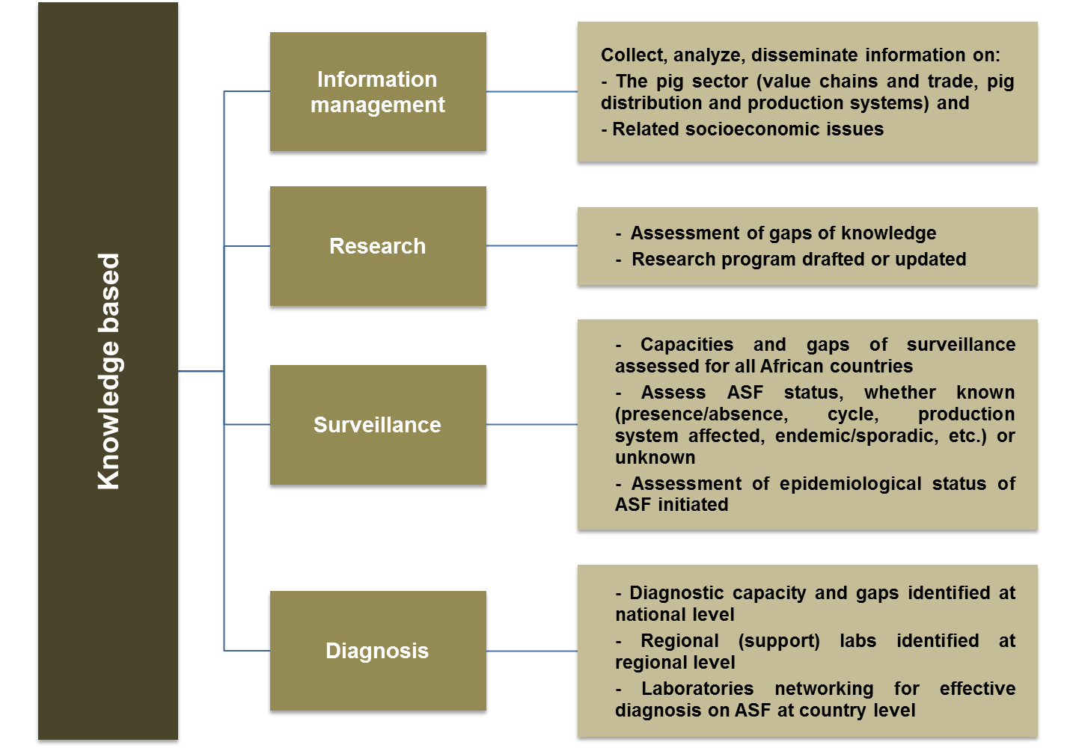
Short term (1-3 years)

Slide 22
Short-term (1-3 years)
Area-specific
Biosecurity
Outbreak management and recovery
Awareness, communication and information
- Development of a biosecurity strategy
- Awareness and sensitization on biosecurity initiated
- Biosecurity measures for cross-border trade harmonized
- Existing outbreak management and recovery tools assessed
- Preparedness and contingency plans for all infected and at risk countries formulated adopted and initiated
- Feasible outbreak management tools to the African context adapted, explored and harmonized
-Compensation mechanisms developed, harmonized and promoted
- Emergency ASF funds established
- Communication strategy at all level developed and adopted (global, sub-regional, national, donors and international organizations)
- Communication strategy implementation initiated (Start adoption e.g. flyer, PowerPoint, website on the initiative)

Slide 23
Short-term (1-3 years)
Holistic
Development /
organization of the pig sector
Coordination, partnership and resource mobilization
Harmonization of policy and legislation
- Mapping existing initiatives for the development of the pig sector
- Support to Producers’ associations in improving husbandry, genetics, feed, housing and access to market initiated
- Strategy for the development and organization of the pig sector conducted
- Continental ASF Working Group constituted
- Gaps in legislation and policies assessed (in ASF-affected and at risk countries)

Slide 24
Medium-term (3-7 years)
Knowledge base
Information management
Surveillance
Diagnosis
Research
- Review and update information
- Effective surveillance systems in place
- Epidemiological status of ASF known (prevalence known)
- National laboratories capable of diagnosing ASF
- Uptake or search for better diagnostic technologies
- Results of Research program validated and disseminated

Slide 25
Medium-term (3-7 years)
Area-specific
Biosecurity
Outbreak management and recovery
Awareness, communication and information
- Biosecurity measures are maximized at all level (cross border, VC and farms)
- Value chain analysed and critical control points and biosecurity mitigation measures identified and promoted at sub-regional level (including socioeconomic issues
- Biosecurity measures widely adopted, promoted and incorporated in national policies and regulations
- Compensation mechanisms reinforced
- Funds for compensation scheme established
- Emergency ASF funds maintained
- Communication strategy implemented

Slide 26
Medium-term (3-7 years)
Holistic
Development /
organization of the pig sector
Coordination, partnership and resource mobilization
Harmonization of policy and legislation
- Producers’ associations in improving husbandry, genetics, feed, housing and access to market supported
- Network of stakeholders established
- Legislation and implementation gaps (in all African countries) assessed
- Appropriate legislation adopted and enforced
- Policies and action plan formulated and implemented in ASF (ASF-affected and at risk countries)
- Countries adopt an action plan to enforce the legislation (ASF-affected and at risk countries)

Slide 27
Long-term (over 7 years)
Knowledge base
Information management
Surveillance
Diagnosis
Research
- Sustainable information system (platform, protocol, network for exchange)
- Surveillance systems in full operation
- Better diagnostic technologies introduced
(e.g. Pen-side diagnostics)
- Research Results on the transformation of the pig sector made available

Slide 28
Long-term (over 7 years)
Area-specific
Biosecurity
Outbreak management and recovery
Awareness, communication and information
- Biosecurity measures are enforced at all level (cross border, VC and farms)
- Emergency ASF funds maintained
- Communication strategy reviewed and updated

Slide 29
Long-term (over 7 years)
Holistic
Development /
organization of the pig sector
Coordination, partnership and resource mobilization
Harmonization of policy and legislation
- Transformation of the pig sector promoted
- Network of stakeholders expanded
- Measures to enforce legislation in place
- Policies and action plan in place

Slide 30
Next Steps
Publication of the joint proposed strategy;
Submission to GF-TADs Africa for awareness and labeling;
TCP facilities for to develop a continental control program Development with FAO;
Validation stakeholder workshop (MS, RECs and Partners GARA, Research Institutions..)
Resource mobilization for implementation,

Slide 31
Acknowledgment
Task Force Members
ILRI
Global platform for ASF
Members States

Slide 32
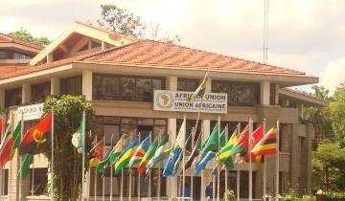
Thank You/Merci
www.au-ibar.org
AU-IBAR:
Providing Leadership in the Development of Animal Resources for Africa

